Slide 1


Slide 2
The Consumer Protection Act 1986
This Act attempts to give consumer complete protection from malpractices of manufacturers producers suppliers wholesalers retailers and providers of various services the act is designed to make available inexpensive and speedy justice to consumers
The primary goal is to protect consumers from unfair trade practices and ensure the availability of goods and services at reasonable prices.

Slide 3
The Consumer Protection Amendment Act, 2002
The Consumer Protection Act, 2002 is expected to greatly facilitate the working of the consumer disputes redressal agencies in the country and help in achieving speedy settlement of consumer disputes and strengthen consumer movement at grass root level.

Slide 4
The Consumer Protection Amendment Act, 2019
Formation of Central Consumer Protection Authority
Now complainant can filed in a consumer court where the complainant resides or works, earlier complainant could be filed in a consumer court where the sellers office is located
Consumer can seek compensation for harm caused by a product or service. Earlier consumer could only approach a civil court but not a consumer court for compensation.
E-commerce transactions are comes under provisions of direct selling.
Consumers can seek hearing through video conference.
Court can of refer settlement through mediation.

Slide 5
Consumer
As defined under Sec 2(e)of the Act , ‘consumer’ means any person who –
A person who buys any goods or hires a service for consideration for a
purpose other than commercial one and any user of such goods or services with the approval of buyer or hirer.

Slide 6
Complainant
Pursuer of a complaint a consumer or any other person/institute /authority eligible to file a complaint under this act
Dispute
Section 2 (e), consumer dispute means a dispute where the person against whom are complaint has been made denies or disputes the allegations contained in the complaint

Slide 7
Defect
Any fault, imperfection or shortcoming in quantity, quality ,potency ,purity or standard of goods required to be maintained under any law or contract or as is claimed by the trader in any manner. for example turmeric powder sold with mixture of yellow color.
Deficiency
Any fault, imperfection, shortcoming or inadequacy in quality nature and manner of performance of service required to be maintained under law or has been undertaken to be performed by a person under the contract. For example A passenger travelled in a deluxe bus but the seat was very much uncomfortable

Slide 8
Restrictive Trade Practices
It includes any trade practices which tends to bring manipulation of price or which affects flow of supplies in the market related to goods and services, which prevent fair competition from other companies.
Unfair Trade Practices
These include false representation, misleading advertisements, and offering goods or services that are hazardous to the health and safety of consumers. False representation includes any statement or claim that is false, misleading, or deceptive in nature.

Slide 9
Who can make complaint ???
a consumer
more then one consumers where consumer having same interest
in case of death of a consumer, his legal heir or legal representative
in case of a consumer being minor, his parent or legal guardian other than that - Central govt, State govt or any Central authority

Slide 10
Rights of Consumers
Consumer Protection Act ensures consumers rights :-
Right to Safety
Right to be Informed
Right to Choose
Right to be Heard
Right to Seek Redressal
Right to Consumer Awareness

Slide 11
Central Consumer Protection Authority (CCPA)
The CCPA is responsible for promoting, protecting, and enforcing consumer rights across the country.
It has wide-ranging powers to regulate and Look into violations of consumer rights, unfair trade practices, false and misleading advertisements and take legal action, and handle customer complaints
Formation And Constitution of CCPA
The Central Authority shall consist of a Chief Commissioner and such number of other Commissioner to be appointed by the Central Government. The Chief Commissioner, is appointed by the Central Government. The Chief Commissioner is assisted by Commissioners, who are also appointed by the Central Government.
The CCPA has its headquarters in New Delhi, and it has the power to establish regional offices throughout the country.

Slide 12
The CCPA has several functions, including:-
Conducting investigations into unfair trade practices and misleading advertisements;
Taking action against manufacturers and sellers of unsafe and substandard products;
Issuing orders to recall unsafe products from the market.
Imposing penalties on manufacturers and sellers who violate consumer protection law.
Promoting consumer awareness and education
Advising the Central Government on matters related to consumer protection.

Slide 13
Powers of CCPA
The Central Authority shall protect, promote and enforce the rights of the consumers as a class, and prevent violation of Consumers Rights under the Act.
The CCPA has wide-ranging powers to investigate and take action against
businesses that engage in unfair trade practices or violate consumer protection laws.
It can issue orders to stop the sale of unsafe or substandard products, and it can impose fines and penalty.
Appeal Against Order of CCPA
A person aggrieved by any order passed by the Central Authority may file an appeal to the National Commission within a period of 30 days from the date of receipt of such order.

Slide 14
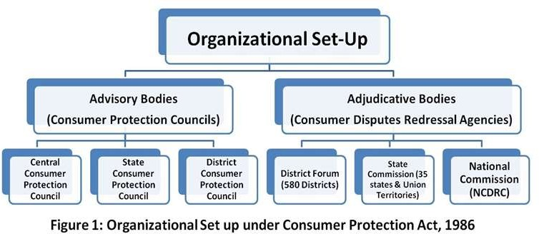

Slide 15
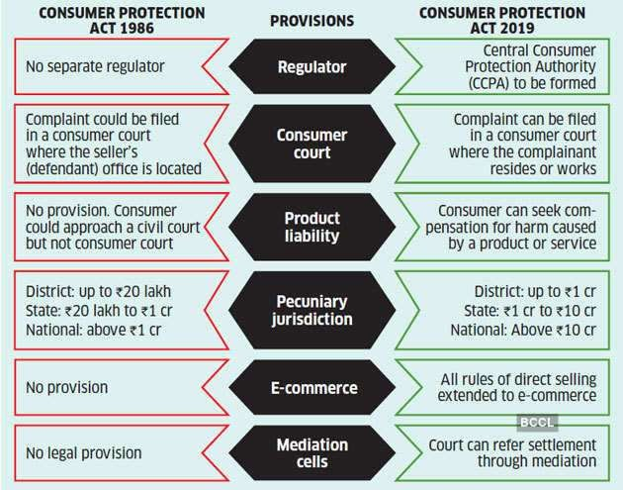

Slide 16
Filing Complaint
A complaint:
Should be in writing & can be filed in a regular way (offline)
Can be filed online By – http://edaakhil.nic.in/
-A complaint can be presented by the complainant in person or by his agent.
-It can even be sent by registered post along with the court fee.
-Normally three copies of the complaint are required to be submitted out of which one retained for the official purpose, one is forwarded to the opposite party and one is the for the complainant.
-In case the number of opposite parties is more, correspondingly more copies of the complaint are required.

Slide 17
Grounds for Filing a Complaint are:
Adoption of unfair trade practice or a restrictive trade practice by the service provider;
Defective goods, whether already bought or agreed to be bought by the complainant;
Deficiency in Services, whether hired or availed or agreed to be hired or availed;
Overcharging of goods or services in excess of the price that may have been fixed by law or displayed on the packaging of goods or the price list exhibited or so agreed between the parties;
Selling or offering to sell hazardous goods or services which pose a threat to life and safety when used or availed provided the trader could know that the goods or services are hazardous by due diligence.

Slide 18
PROCEDURE FOR FILING A COMPLAINT
STEP 1: Intimation via Notice:
A notice to be sent by the aggrieved party to the service provider who provided the goods or the services. The notice communicates the intention of the complainer to resort to litigation and informs him about the defects in the goods or the deficiency in the service or any unfair practice. The notice is also an attempt to settle the complaint without approaching the Forum i.e. if the service provider is willing to offer compensation or any other remedy.

Slide 19
STEP 2: Get the Consumer Complaint Drafted:
If the service provider is not willing to offer compensation or any other remedy, the next step is to file a formal complaint under the Consumer Protection Act, 1986. The filing of the Complaint does not necessarily require a lawyer.
The complaint can be filed by the aggrieved person. The following details must be specified in the complaint:
Name, description and the address of the complainant(s) and the Opposite Party or parties.
. Cause of Action, the approximate date, time and venue.
Relevant facts relating to the cause of action.
The Relief or Remedy claimed by the complainant in accordance with the facts of the case.
Signature and Verification by the complainant or his authorized agent

Slide 20
STEP 3: Attach Relevant Documents:
Copies of material evidence and relevant documents that support your case in Consumer Court are important. These documents include:
A copy of the bill, receipt of delivery, packaging of a product, a record of online
booking of the goods bought Warranty/Guarantee certificates
A copy of the written complaint and notice sent to the manufacturer/seller.
STEP 4: Appropriate Forum:
Choose the appropriate forum for filing the complaint in accordance with the pecuniary jurisdiction which is estimated in reference to the total value of goods and services bought or availed and the amount of compensation sought.

Slide 21
STEP 5: Pay Requisite Court Fees:
A prescribed fee is required to be paid along with the complaint filed depending on the forum. The court fee depends upon the value of goods bought and the amount of compensation sought.
STEP 6: Submit an Affidavit:
The person who wants to file a case in the Consumer Court is also required to submit an affidavit in the court. The affidavit must state that the facts presented and statements made by the consumer are true to their knowledge.
(If the consumer is not satisfied with the order of the Consumer commission , can prefer an appeal in the higher commission within a period of thirty days from the date of the order. )

Slide 22
Remedies Available:-
Removal of defects from the goods;
Replacement of the goods;
Refund of the price paid;
Removal of defects or deficiencies in the services;
Award of compensation for the loss or injury suffered;
Discontinue and not to repeat unfair trade practice or restrictive trade practice;
To withdraw hazardous goods from being offered for sale;
To cease manufacture of hazardous goods and desist from offering services which are hazardous in nature;
If the loss or injury has been suffered by a large number of consumers who are not identifiable conveniently, to pay such sum (not less than 25% of the value of such defective goods or services provided) which shall be determined by the Commission;
To issue corrective advertisement to neutralize the effect of misleading advertisement;
To provide adequate costs to parties.

Slide 23
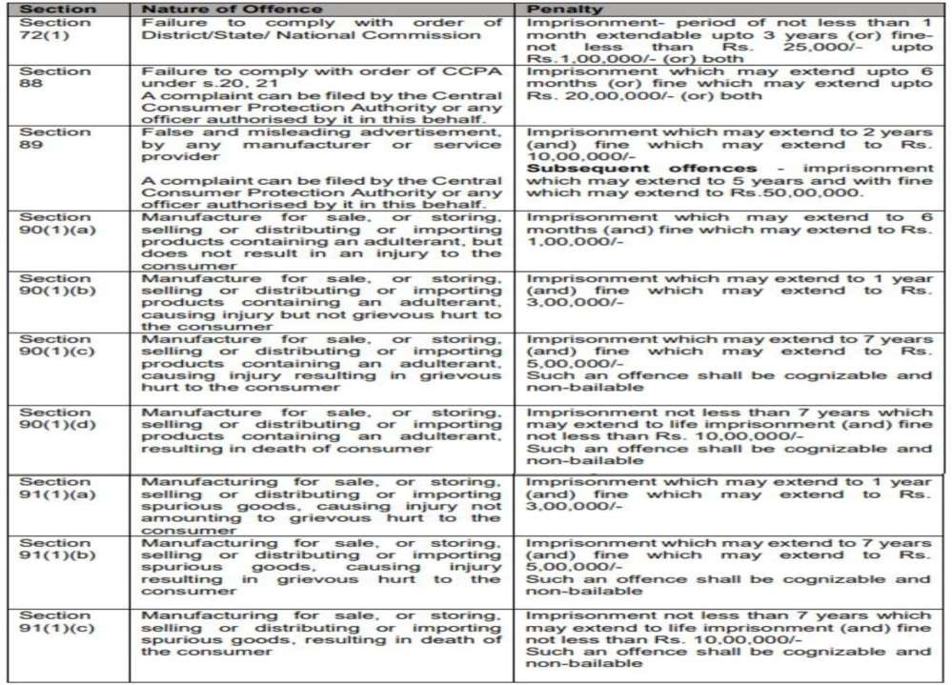
Offences & Penalties

Slide 24
Consumer complaint be resolved through mediation?
Either at the first hearing after admission, or at later stage if the District Commission is of the view that, there exists an element of settlement, can refer the complaint to Mediation with the consent of the parties

Slide 25


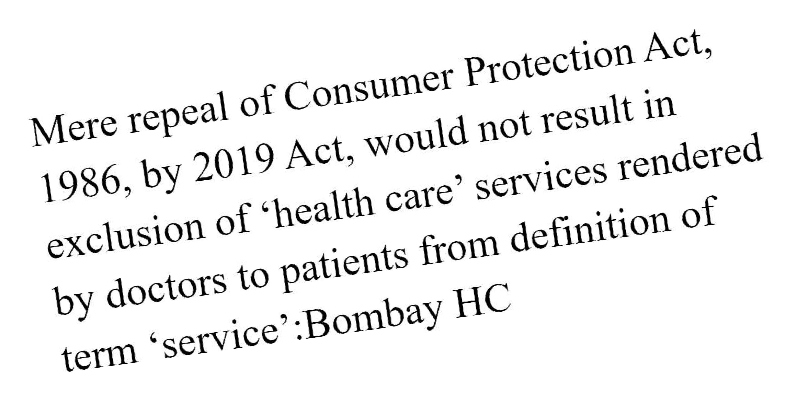


Slide 26
References
http://www.surendranatheveningcollege.com/wp- content/uploads/2020/09/process-of-filing-a-complaint-in-a-consumer-court.pdf

Slide 27


The End !

